Slide 1
Technical Bootcamp
Week 2
Akshita Verma
IT Data Engineer

Slide 2
Day 1
Normalization: Normalization is the method used in a database to reduce the data redundancy and data inconsistency from the table. It is the technique in which non-redundancy and consistency data are stored in the set schema. By using normalization, the number of tables is increased instead of decreased.
Denormalization: Denormalization is also the method which is used in a database. It is used to add the redundancy to execute the query quickly. It is a technique in which data are combined to execute the query quickly. By using denormalization the number of tables is decreased which oppose to the normalization.

Slide 3
Day 1
Data Warehouse: It is separate from DBMS, it stores a huge amount of data, which is typically collected from multiple heterogeneous sources like files, DBMS, etc. The goal is to produce statistical results that may help in decision makings. For example, a college might want to see quick different results, like how the placement of CS students has improved over the last 10 years, in terms of salaries, counts, etc.
Data Lake: A data lake is a storage repository designed to capture and store a large amount of all types of raw data. The data can be structured, semi-structured, and unstructured. Once it’s in the data lake, the data can be used in machine learning or artificial intelligence AI algorithms and models for business purposes. It can also be transferred to a data warehouse after processing.

Slide 4
Day 2
OLTP: It stands for Online Transactional Processing. OLTP has the work to administer day-to-day transactions in any organization. The main goal of OLTP is data processing not data analysis.
OLAP: Online Analytical Processing consists of a type of software tool that is used for data analysis for business decisions. OLAP provides an environment to get insights from the database retrieved from multiple database systems at one time.
Dimensional Modelling: Dimensional data modeling is a technique used in data warehousing to organize and structure data into facts and dimensions. Dimensional model in data warehouse is designed to read, summarize, analyze numeric information like values, balances, counts, weights, etc. in a data warehouse. In contrast, relation models are optimized for addition, updating and deletion of data in a real-time Online Transaction System.

Slide 5
Day 2
Fact table: A fact table is the central table in a star schema of a data warehouse. A fact table stores quantitative information for analysis and is often denormalized.
A fact table works with dimension tables. A fact table holds the data to be analyzed, and a dimension table stores data about the ways in which the data in the fact table can be analyzed. Thus, the fact table consists of two types of columns. The foreign keys column allows joins with dimension tables, and the measures columns contain the data that is being analyzed.
Snowflake schema: Here, the centralized fact table is connected to multiple dimensions. In the snowflake schema, dimensions are present in a normalized form in multiple related tables. The snowflake structure materialized when the dimensions of a star schema are detailed and highly structured, having several levels of relationship, and the child tables have multiple parent tables. The snowflake effect affects only the dimension tables and does not affect the fact tables.

Slide 6
Day 3 SQL queries
1.Create: used to create database/table in SQL
CREATE TABLE TABLENAME( Col_name col_type)
2.SELECT: used to fetch results from table
SELECT * FROM TABLENAME
3.Join: It is used to combine rows from two or more tables.
4.Group by: The GROUP BY statement groups rows that have the same values into summary rows.The GROUP BY statement is often used with aggregate functions (COUNT(), MAX(), MIN(), SUM(), AVG()) to group the result-set by one or more columns.

Slide 7
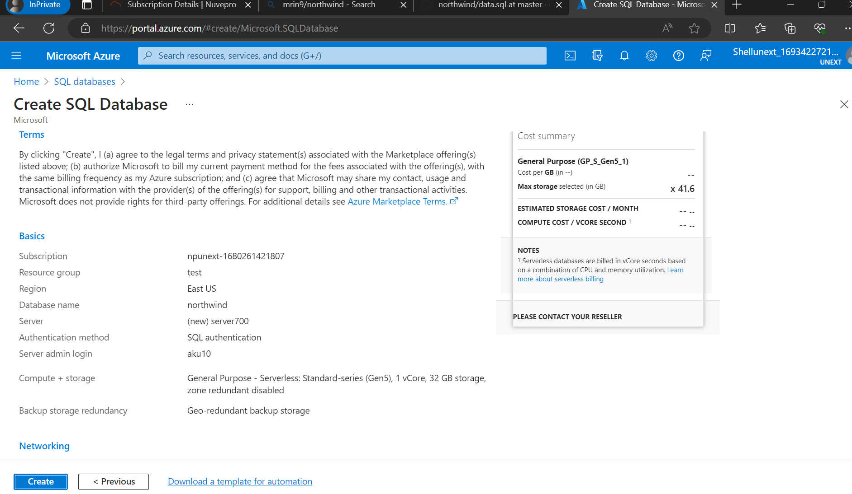
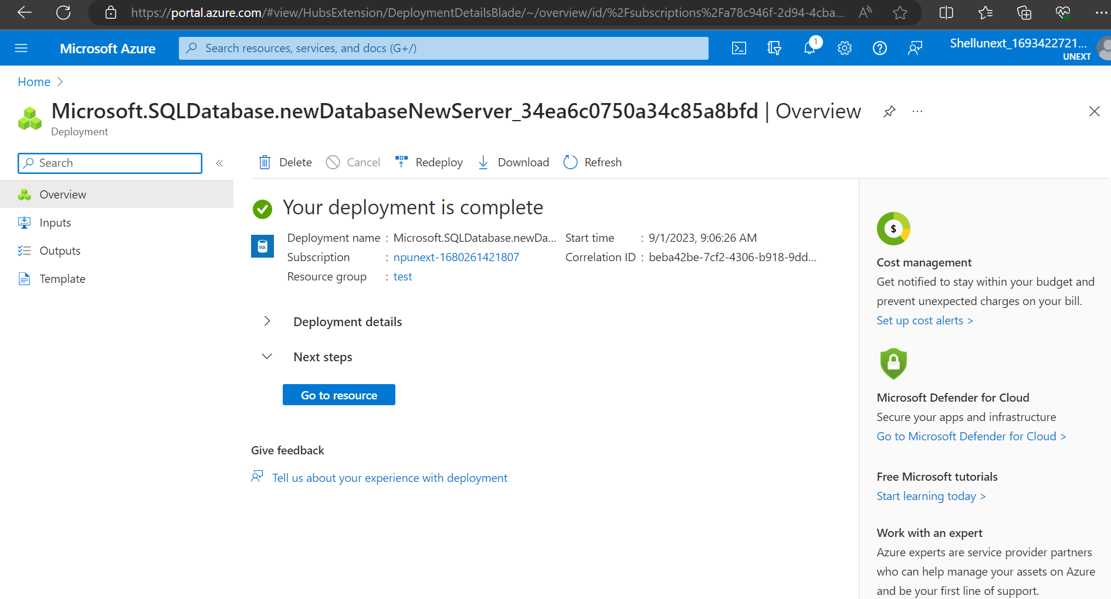
Day 4 Azure SQL

Slide 8
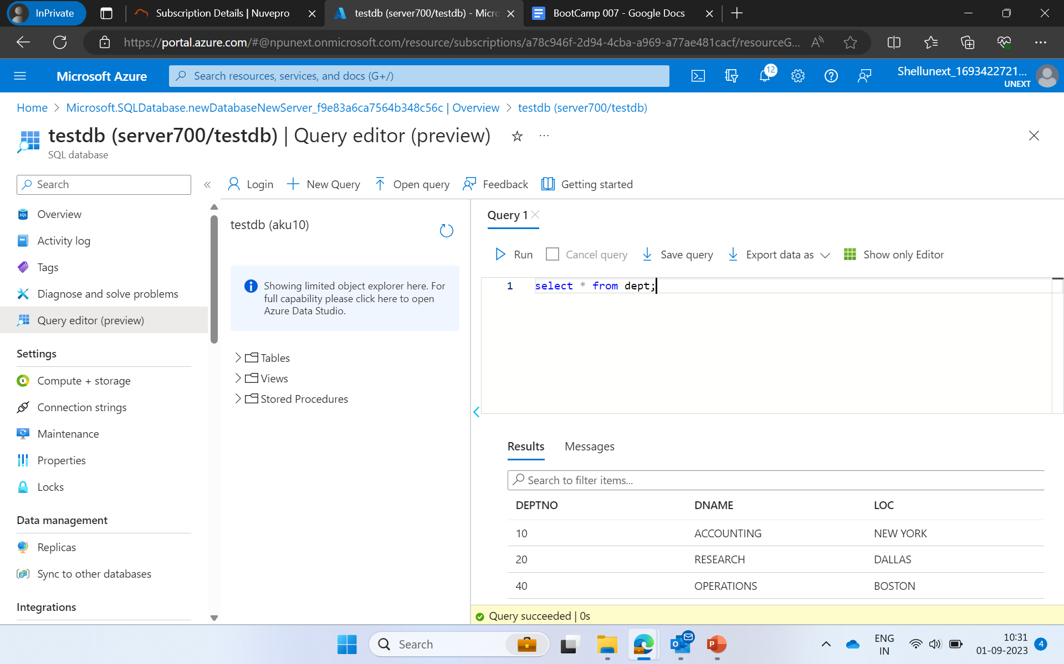
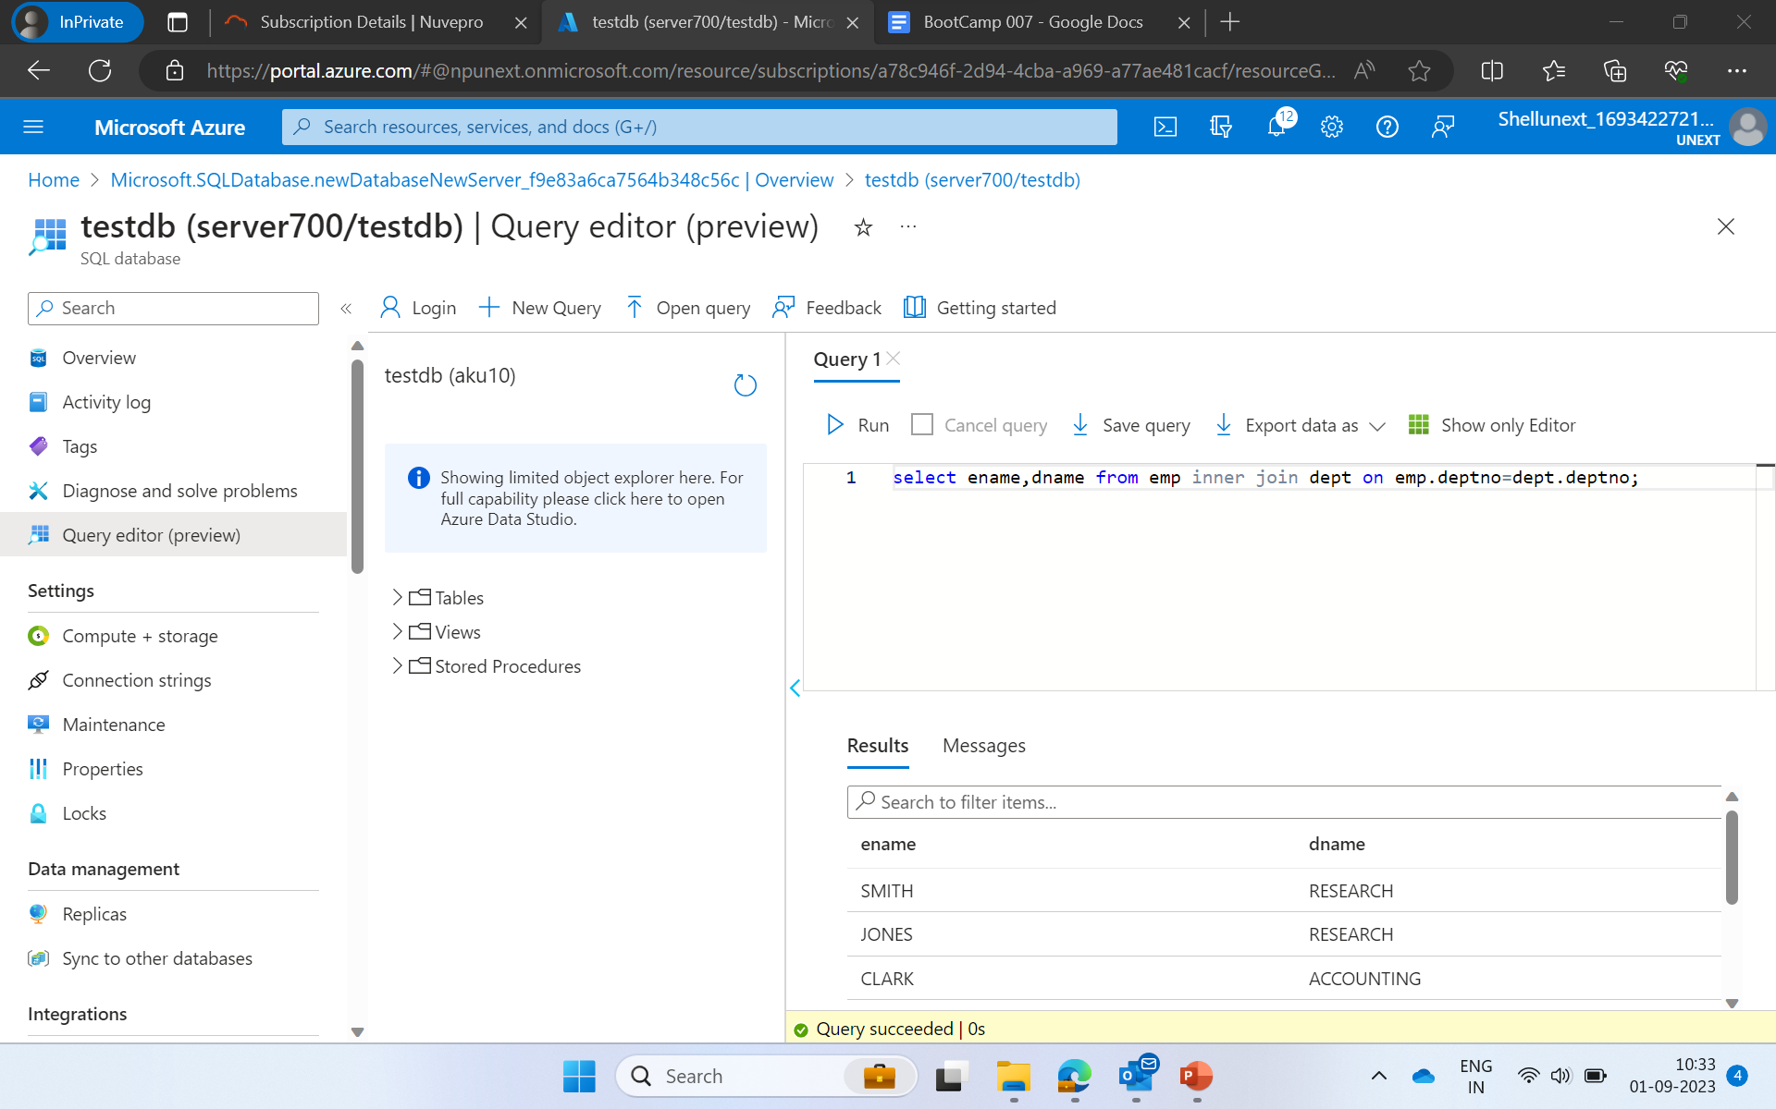
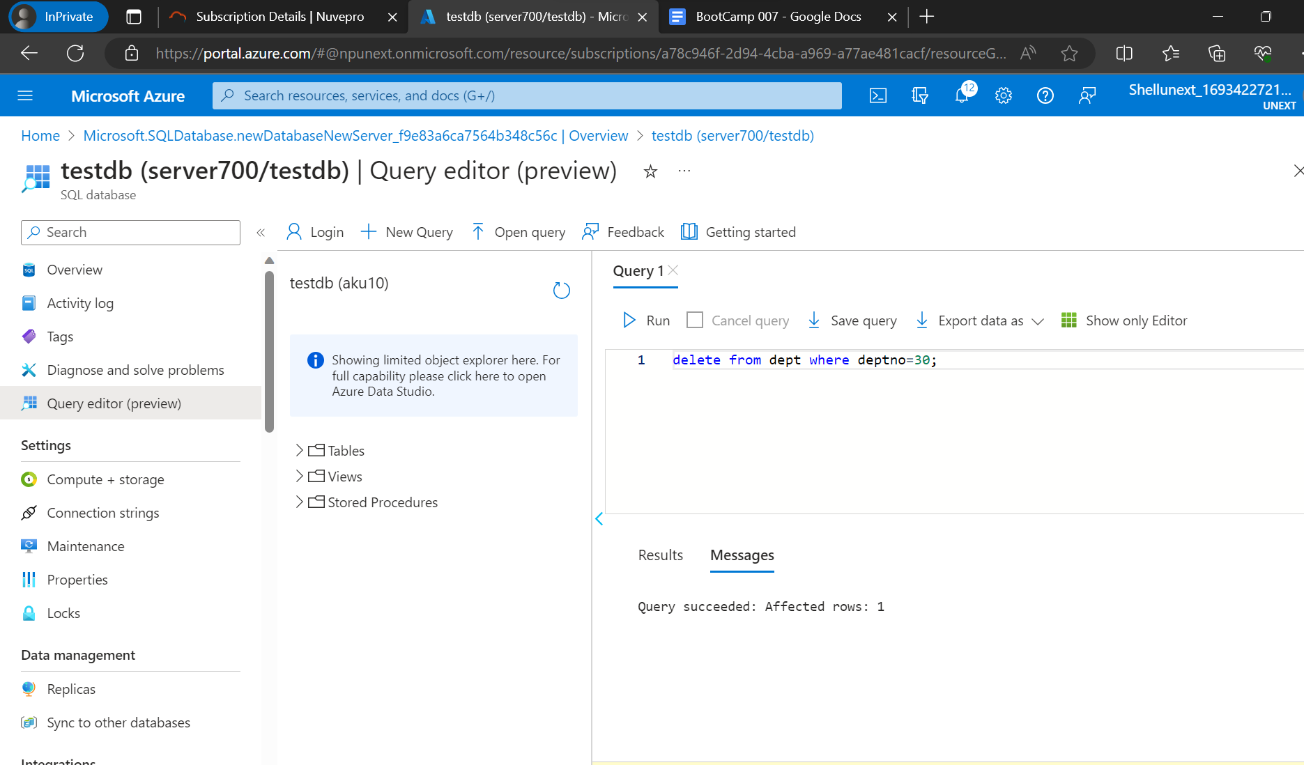
Day 4 Azure SQL

Slide 9
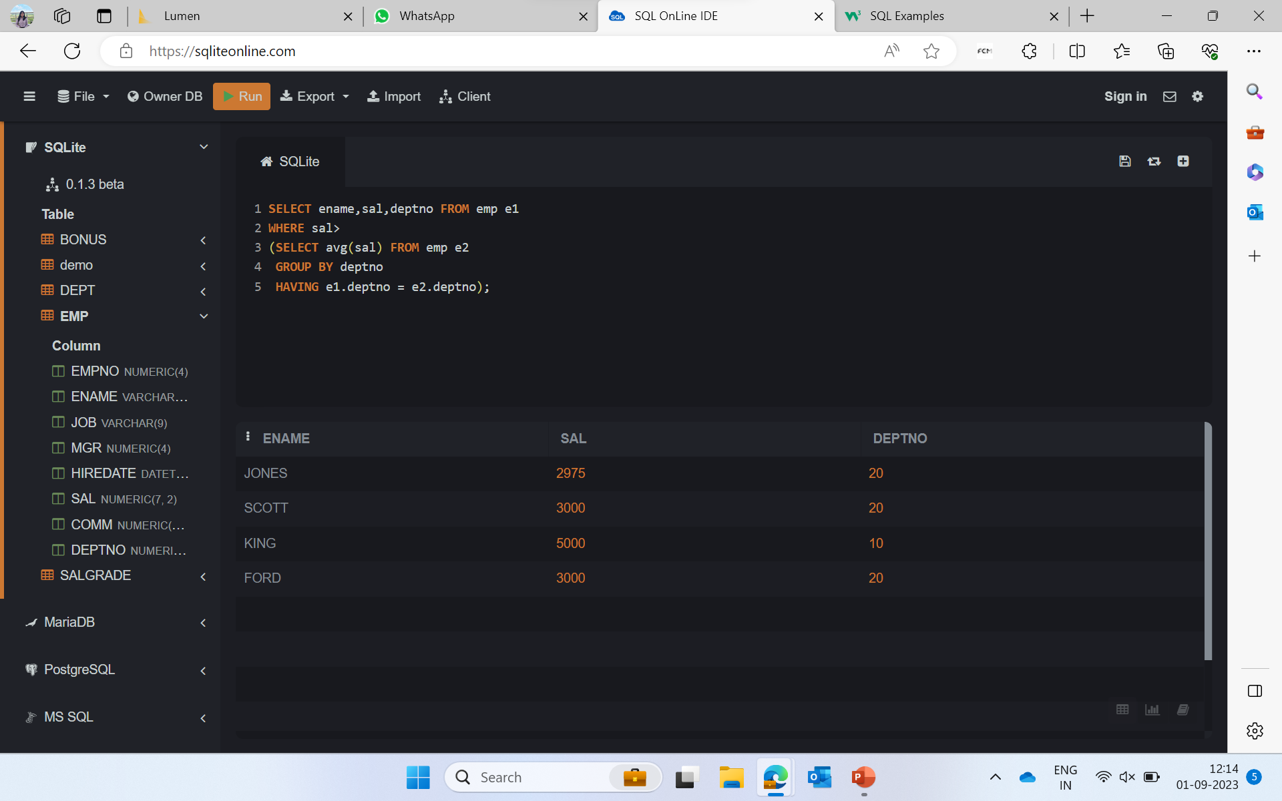
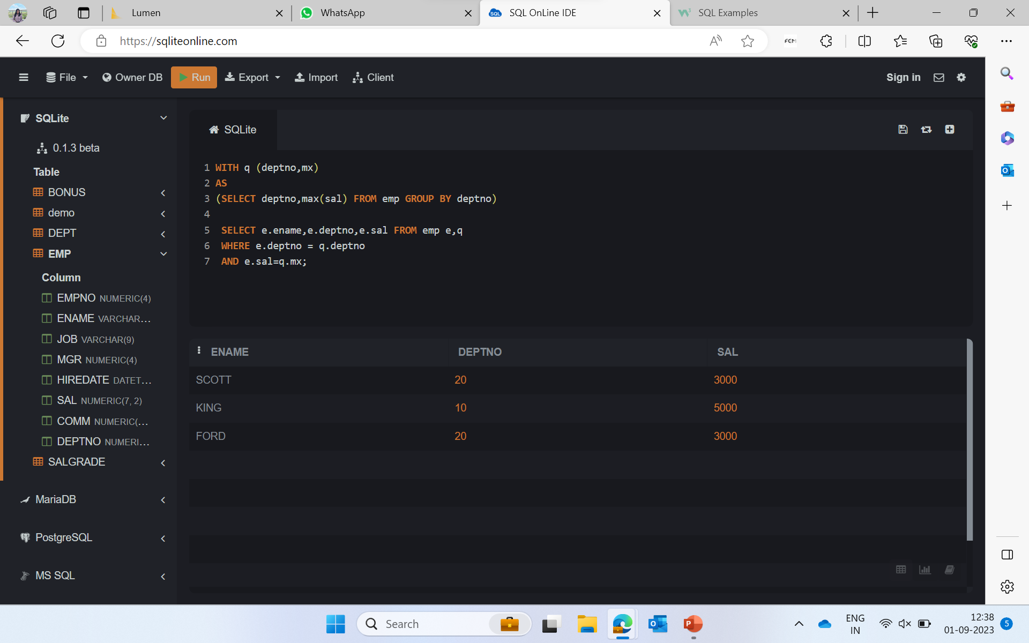
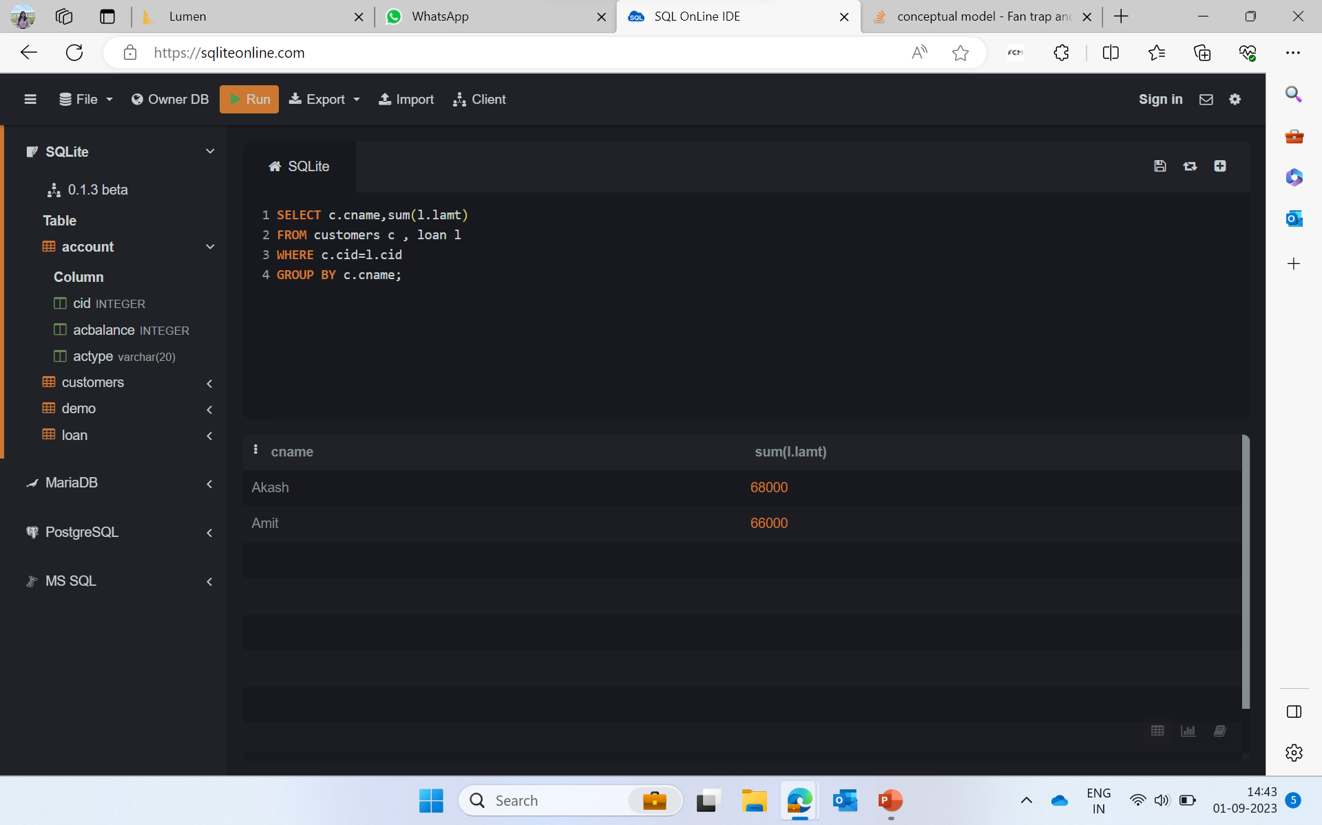
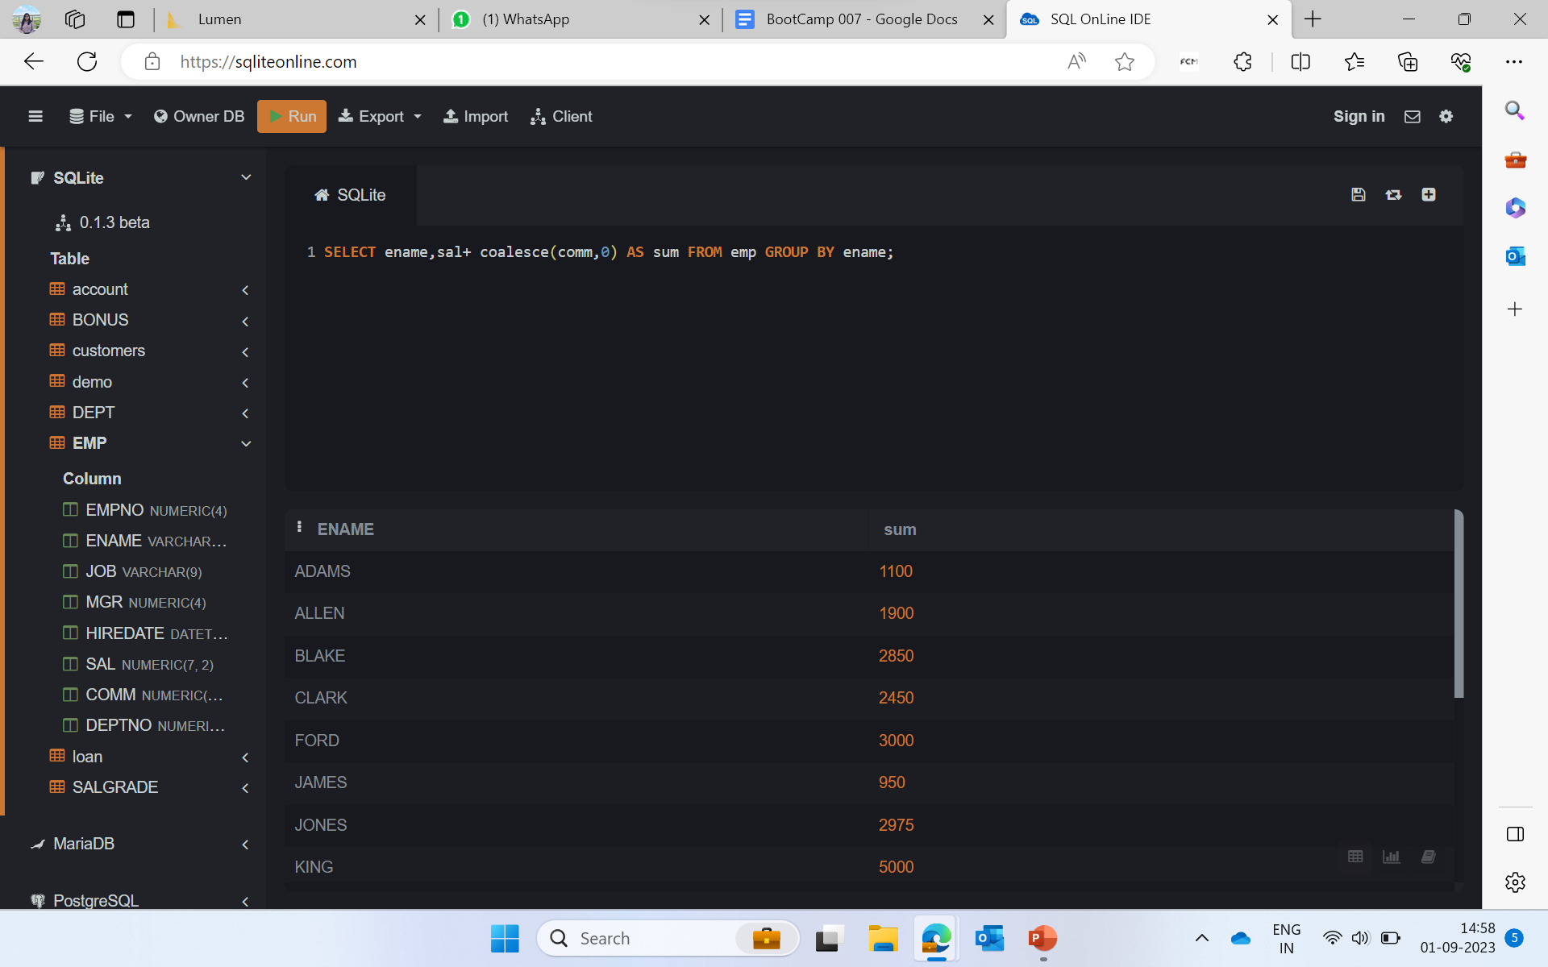
Day 5: Hands on (case study)

